Slide 1
Sexually Transmitted Infections
AEHBY Human Biology

Slide 2
Review
List three unique structures of foetal circulation (3).
What signals the end of the first stage of labour? (1)
List 5 hormones involved in menstruation and pregnancy (5)

Slide 3
Learning Intentions
Sexually transmitted infections (STIs), diseases transmitted through unprotected sex or genital contact, can be prevented through safe sex methods; early detection and treatment of infection are important and, if left untreated, STIs can lead to serious health consequences.

Slide 4
Success criteria
Define STIs
Describe examples of STIs, their symptoms and effects.

Slide 5
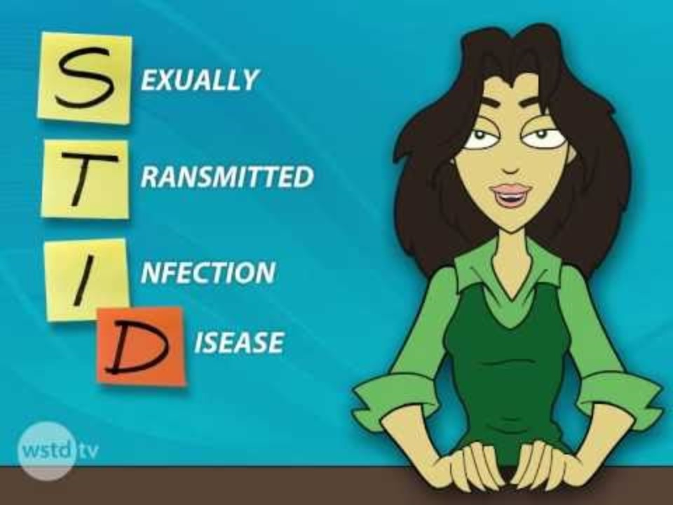

Slide 6
AEHBY (wheelofnames.com)
STI questions (wheelofnames.com)

Slide 7
Create a PSA short video or animation
signs
symptoms
effects
treatments
prevention
statistics (au)

Slide 8
Success criteria
Define STIs
Describe examples of STIs, their symptoms and effects.

